Slide 1
Set Up EKS Cluster for Orchestration (Kubernetes)

Slide 2
What is Kubernetes?
Kubernetes is open-source software.
It helps you deploy and manage containerized applications.
Kubernetes has a large community.

Slide 3
What is Amazon EKS?
Amazon Elastic Kubernetes Service (EKS) is a cloud-based container management service that natively integrates with Kubernetes to deploy applications.
The EKS service automatically manages and scales clusters of infrastructure resources on AWS with Kubernetes.
With Amazon EKS, an enterprise can use Kubernetes without having to install, operate or manage the container orchestration software.

Slide 4
EKS cluster can be created in following ways:
1. Setup an EC2 Instance to create a cluster
2. Setup kubectl
3. Setup eksctl
4. Create an IAM Role and attach it to the EC2 instance
5. Create your cluster and nodes
6. Deploying Nginx Container
7. Delete the EKS cluster

Slide 5
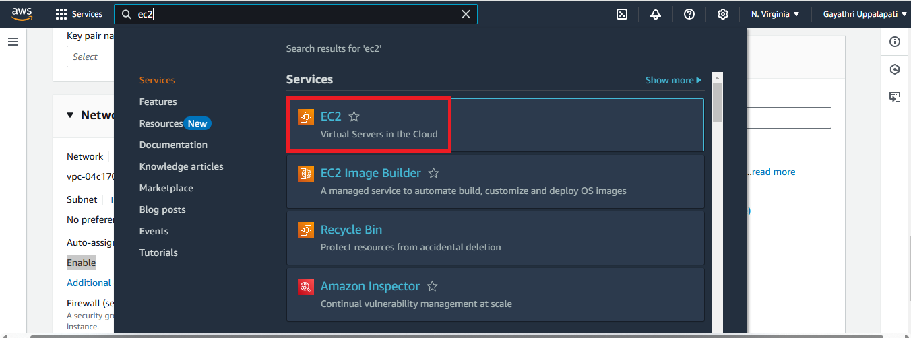
installing and Set Up EKS Cluster on AWS EC2:-
1. AWS Account:
Sign up for an AWS account: If you don’t already have one, create an AWS account at aws.amazon.com.
2. AWS EC2 Instance:
Launch an EC2 instance:
1.Go to the AWS console and navigate to the EC2 service.

Slide 6
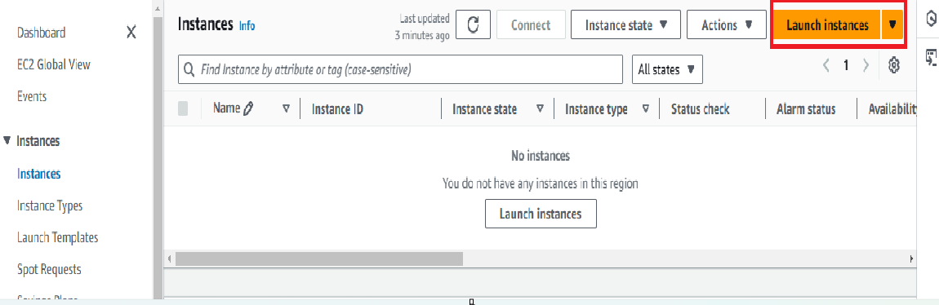
Next Click on Launch Instance button.

Slide 7
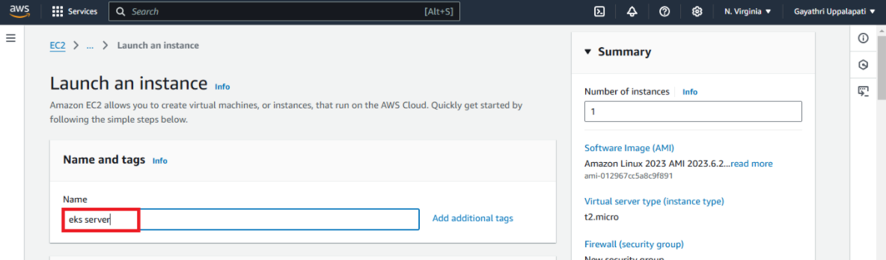
Go to the names and tags and give the Name as eks server (Any Name).

Slide 8
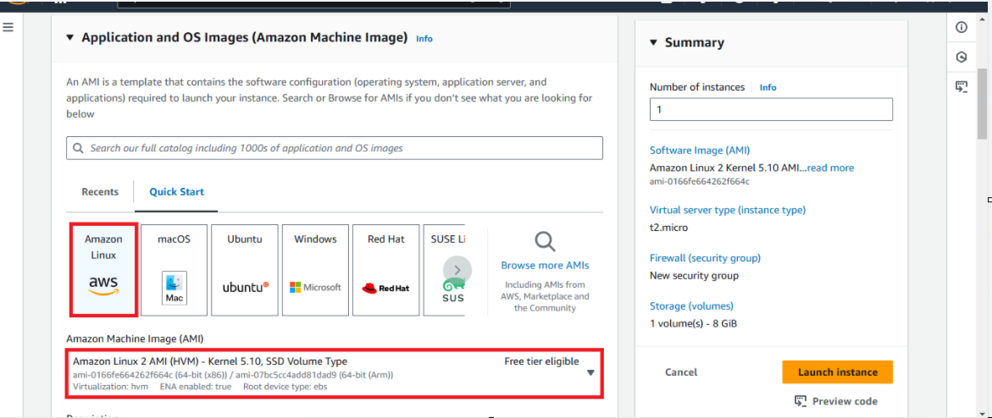
Operating System: Amazon Linux 2 AMI (HVM) - Kernel 5.10, SSD Volume Type (64-bit x86)

Slide 9
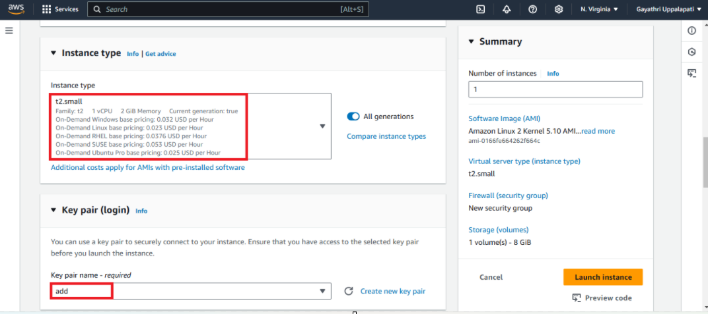
Instance type: For this an t2.small instance
Key Pair :Choose an existing key pair or create a new key pair

Slide 10
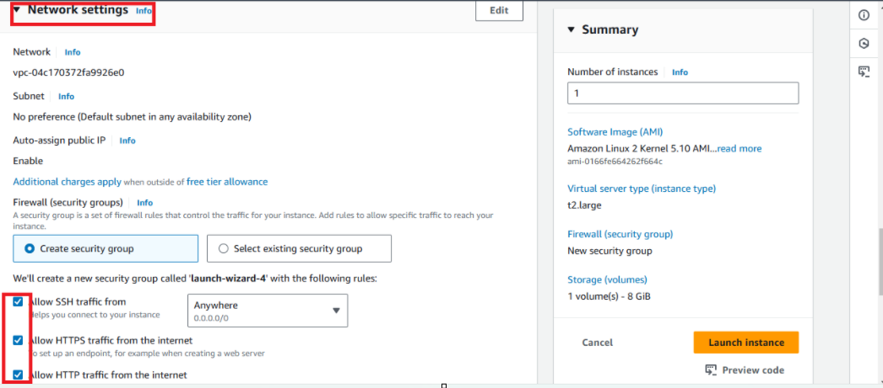
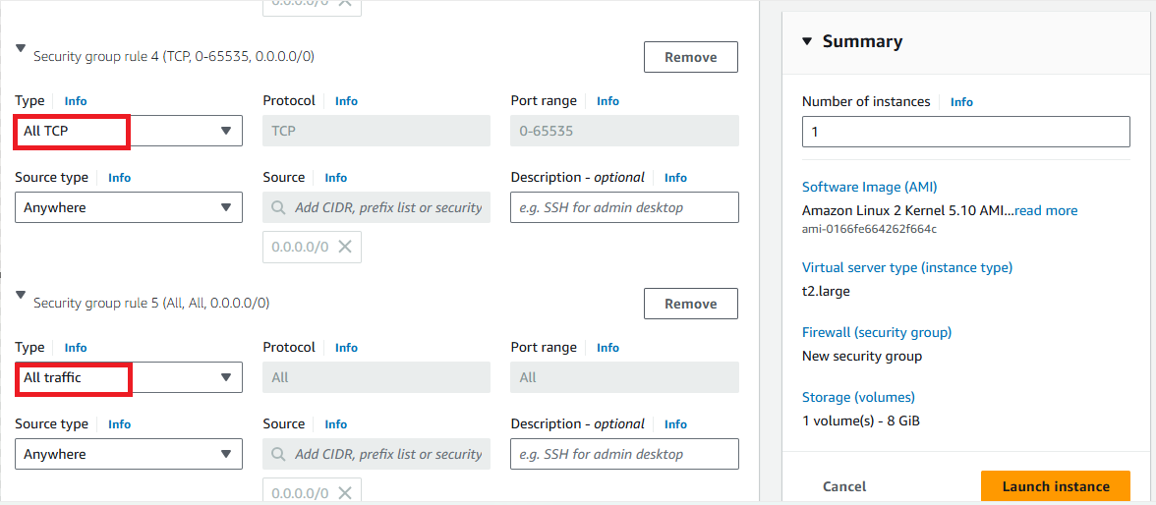
Security Group: network settings edit the auto-assign public IP as Enable. and then Allow the HTTP & HTTPS then click on Edit then add security group with All TCP then All traffic click on Launch Instance.

Slide 11
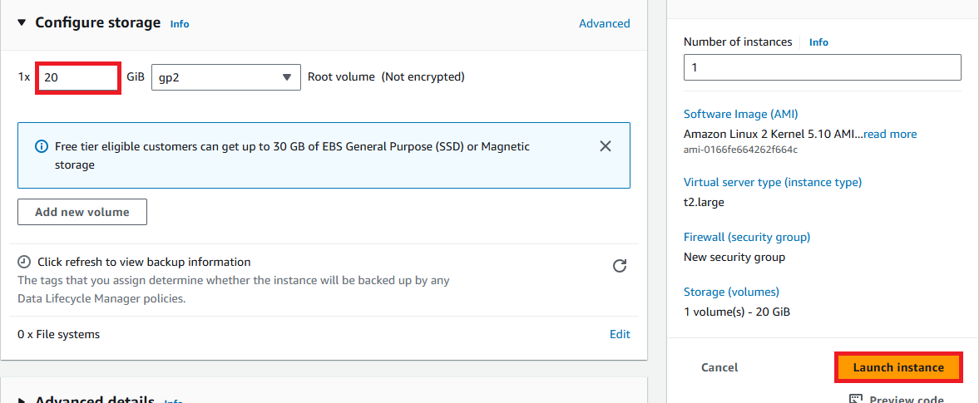
configure storage : 20 gb

Slide 12
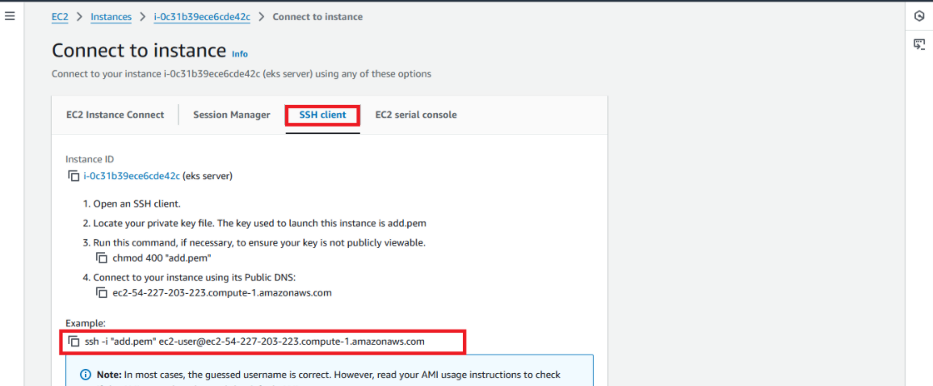
After the Instance Created then Connect the instance with any
tool(GIT,Mobaxterm etc..,) with SSH Key.

Slide 13
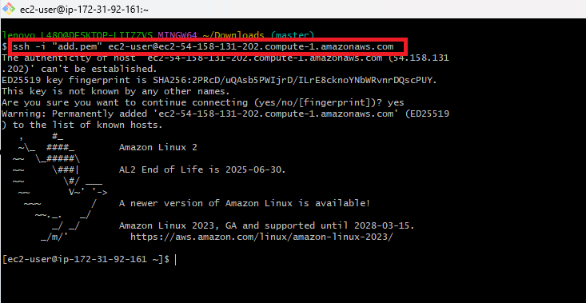
After Copy the SSH link paste that in any tool (GIT,Mobaxterm etc..,) to connect with AWS

Slide 14
Install the AWS CLI version 2 on Linux | How to Install the AWS CLI version 2 on Linux
sudo yum update -y
curl "https://awscli.amazonaws.com/awscli-exe-linux-x86_64.zip" -o "awscliv2.zip"
unzip awscliv2.zip
sudo ./aws/install
aws --version

Slide 15

Install eksctl on Linux Instance:
The eksctl tool uses CloudFormation under the hood, creating one stack for the EKS master control plane and another stack for the worker nodes.
Download and extract the latest release of eksctl with the following command.
curl --silent --location "https://github.com/weaveworks/eksctl/releases/latest/download/eksctl_$(uname -s)_amd64.tar.gz" | tar xz -C /tmp
Move the extracted binary to /usr/local/bin
sudo mv /tmp/eksctl /usr/local/bin
eksctl version

Slide 16
how to Install kubectl on Linux Instance:
Kubernetes uses a command line utility called kubectl for communicating with the cluster API server. It is tool for controlling Kubernetes clusters. kubectl looks for a file named config in the $HOME directory.
sudo curl --silent --location -o /usr/local/bin/kubectl https://s3.us-west-2.amazonaws.com/amazon-eks/1.22.6/2022-03-09/bin/linux/amd64/kubectl
sudo chmod +x /usr/local/bin/kubectl
Verify if kubectl got installed
kubectl version --short --client

Slide 17
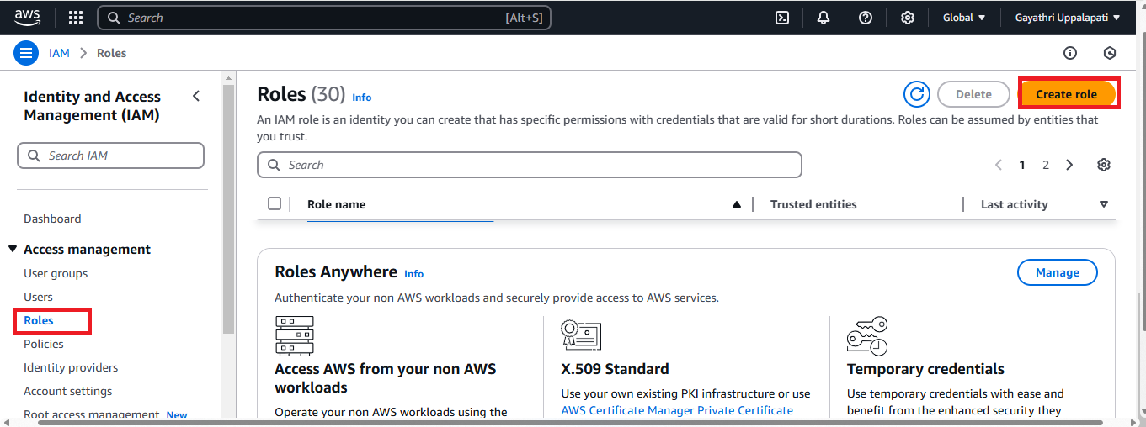
Create IAM Role with Administrator Access:
You need to create an IAM role with AdministratorAccess policy.
Go to AWS console, IAM, click on Roles. create a role

Slide 18
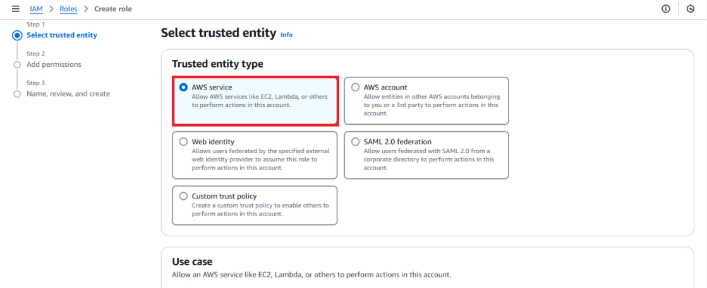
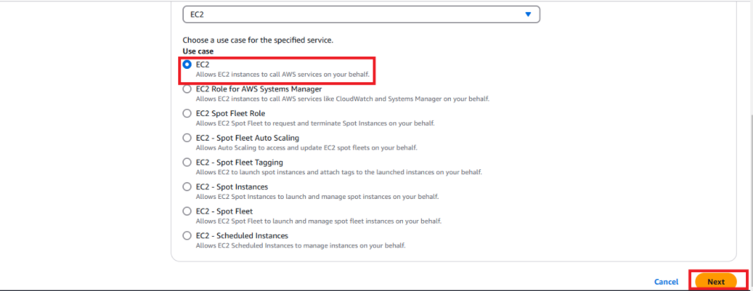
Select AWS services, Click EC2 . Click on Next permissions.

Slide 19
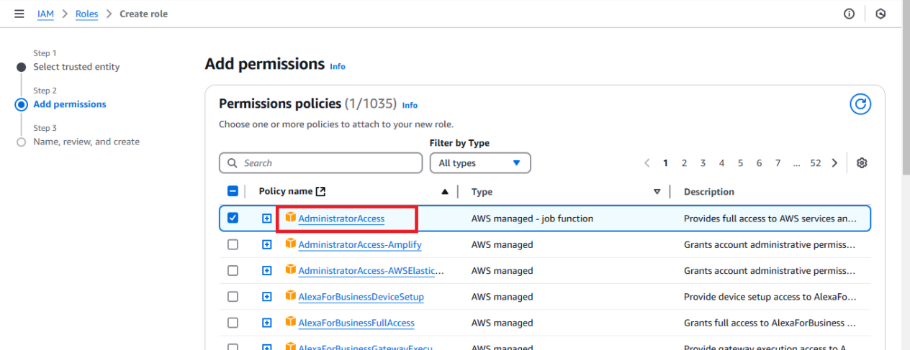
Now search for AdministratorAccess policy and click.

Slide 20
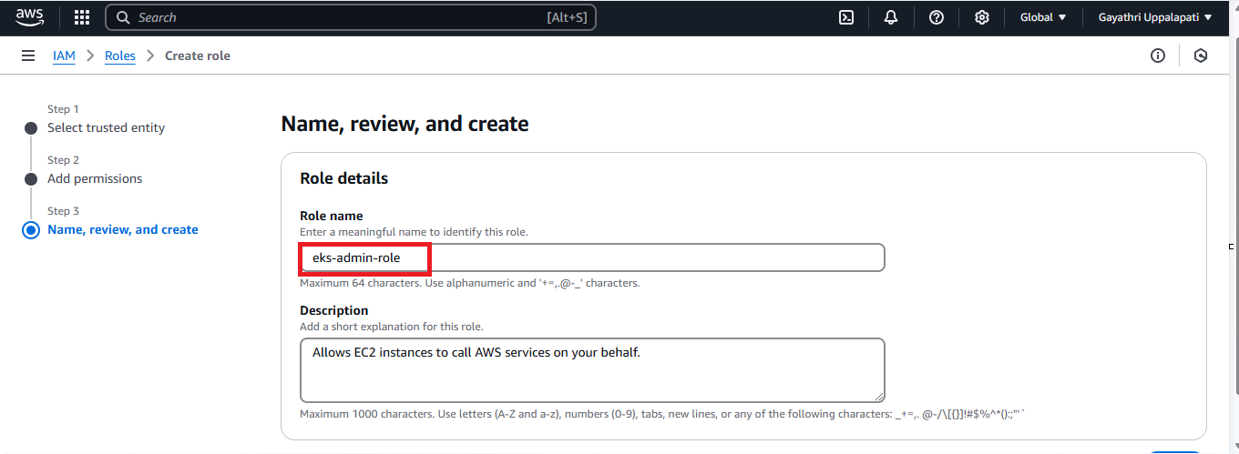
Skip on create tag.
Now give a role name and create it.

Slide 21
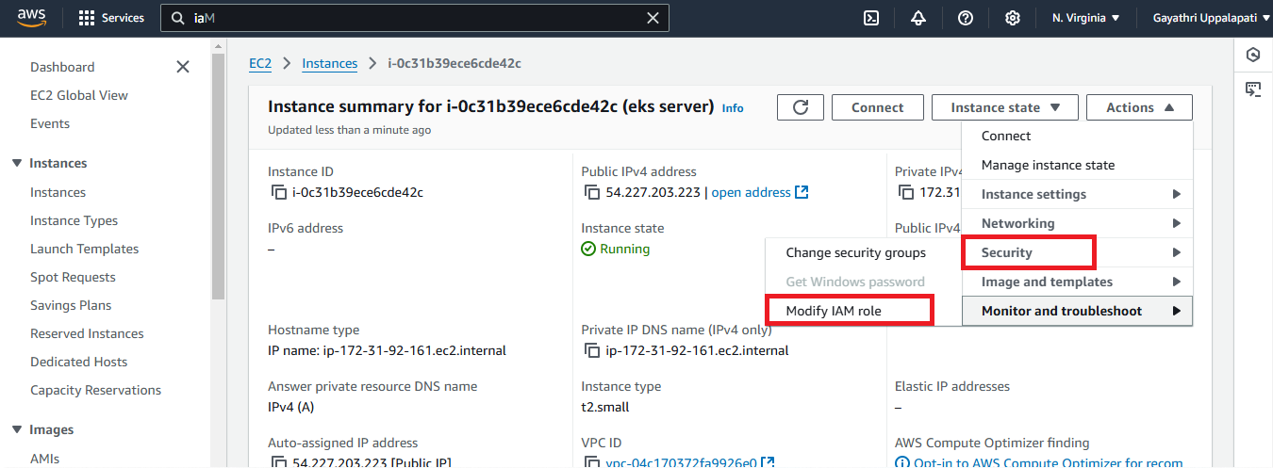
Assign the role to EC2 instance
Go to AWS console, click on EC2, select EC2 instance, Choose Security.
Click on Modify IAM Role.

Slide 22
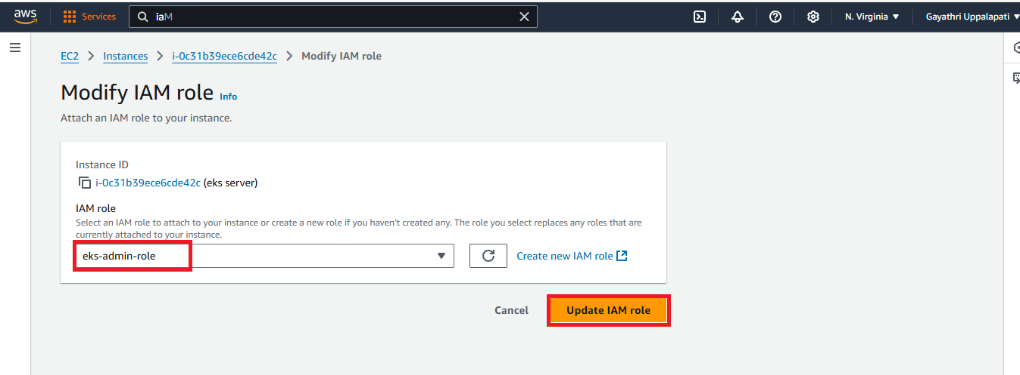
Choose the role you have created from the dropdown.
Select the IAM role and click on Apply.

Slide 23
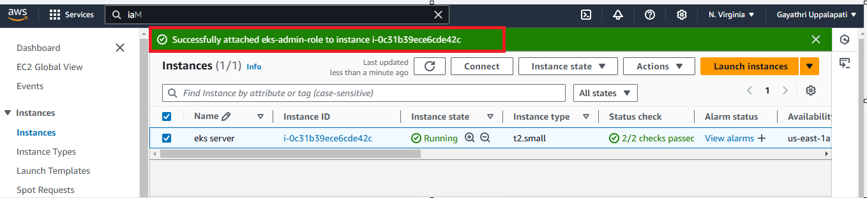
Instances-> successfully attached IAM role.
Exit the this user
Next Switch to Jenkins user
sudo useradd -m Jenkins
sudo su - Jenkins

Slide 24
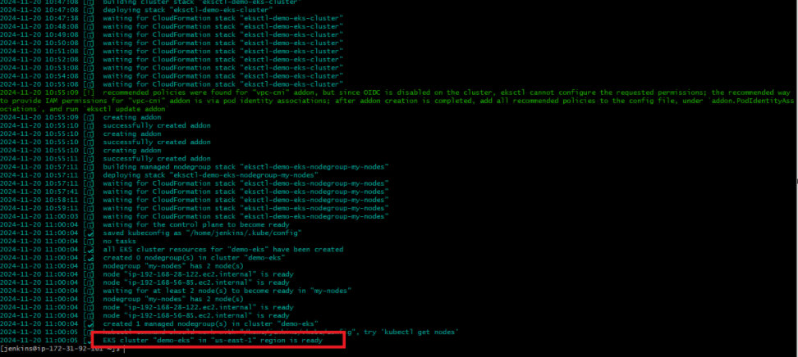
Create EKS Cluster with two worker nodes using eksctl:
eksctl create cluster --name demo-eks --region us-east-1 --nodegroup-name my-nodes --node-type t3.small --managed --nodes 2
the above command should create a EKS cluster in AWS, it might take 15 to 20 mins. The eksctl tool uses CloudFormation under the hood, creating one stack for the EKS master control plane and another stack for the worker nodes.

Slide 25
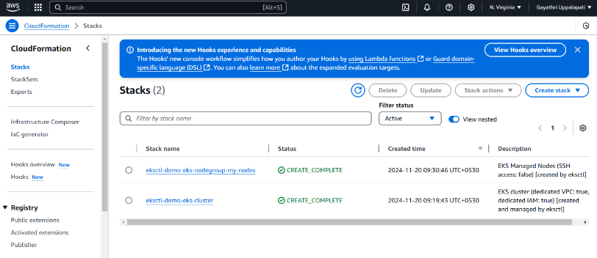
Go to the aws console and search for the cloudformation.
select the cloudformation and create the stacks.
The below image shows that the stacks is successfully created.

Slide 26
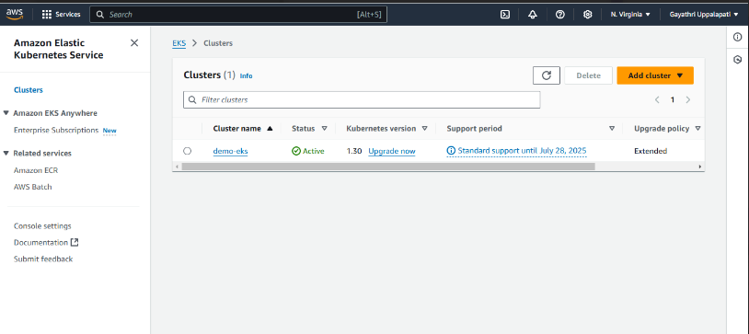
Go to the aws console and search for the Amazon Elastic Kubernetes service .
select the clusters and create the clusters.
The below image shows that the clusters is successfully created.

Slide 27
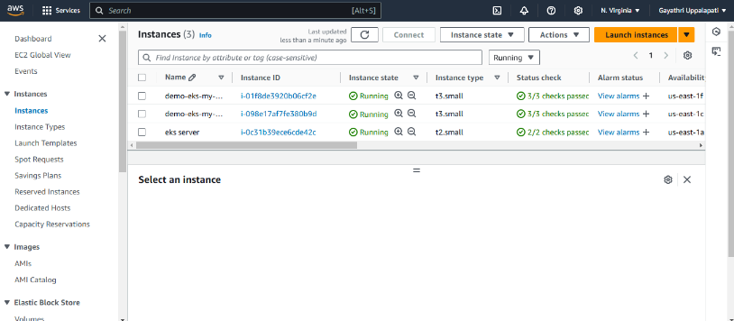
If we check our EC2 dashboard we should see two new nodes as part of our cluster:

Slide 28
eksctl get cluster --name demo-eks --region us-east-1
This should confirm that EKS cluster is up and running.
Update Kube config by entering below command:
aws eks update-kubeconfig --name demo-eks --region us-east-1

Slide 29
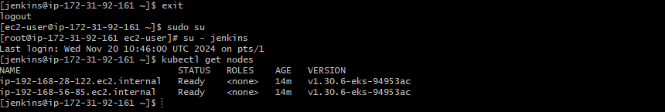
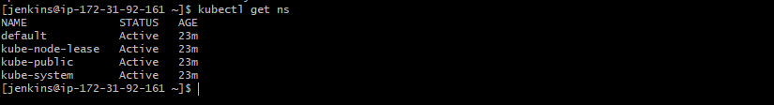
Connect to EKS cluster using kubectl commands
To view the list of worker nodes as part of EKS cluster.
kubectl get nodes
kubectl get ns

Slide 30

Deploy Nginx on a Kubernetes Cluster:
Let us run some apps to make sure they are deployed to Kubernetes cluster. The below command will create deployment:
kubectl create deployment nginx --image=nginx
View Deployments:
kubectl get deployments

Slide 31
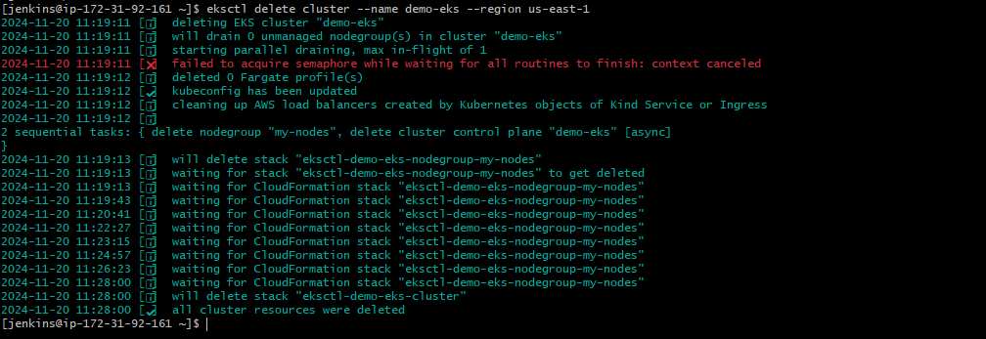
Delete EKS Cluster using eksctl
eksctl delete cluster --name demo-eks --region us-east-1

Slide 32
Conclusion:
In this blog, we learned how to set up a Kubernetes cluster on an EC2 machine using kubectl and eksctl. We also learned how to delete all the resources in the cluster in one go.

